Slide 1
Wireless and Mobile Communication (18CSE458T) Unit-1 Presented By Mr. Nishant Kumar Singh (Assistant Professor) Department of Computer Science and Engineering

Slide 2
Contents
Introduction to Wireless Communication
Elements of Wireless Communication System
Frequencies of Radio Communication
Signals, Noise and it’s types
Introduction to Modulation and Demodulation
Signals in Modulation
Introduction to Analog Modulation Schemes
Amplitude Modulation
Frequency Modulation

Slide 3
Cont'd
Phase Modulation
Amplitude Shift Keying, Frequency Shift Keying
Phase Shift Keying: BPSK, QPSK
Multiplexing and Multiple Access Techniques
FDM, TDM, CDM
Spread Spectrum Modulation
Frequency Hopping Spread Spectrum
Direct Sequence Spread Spectrum

Slide 4
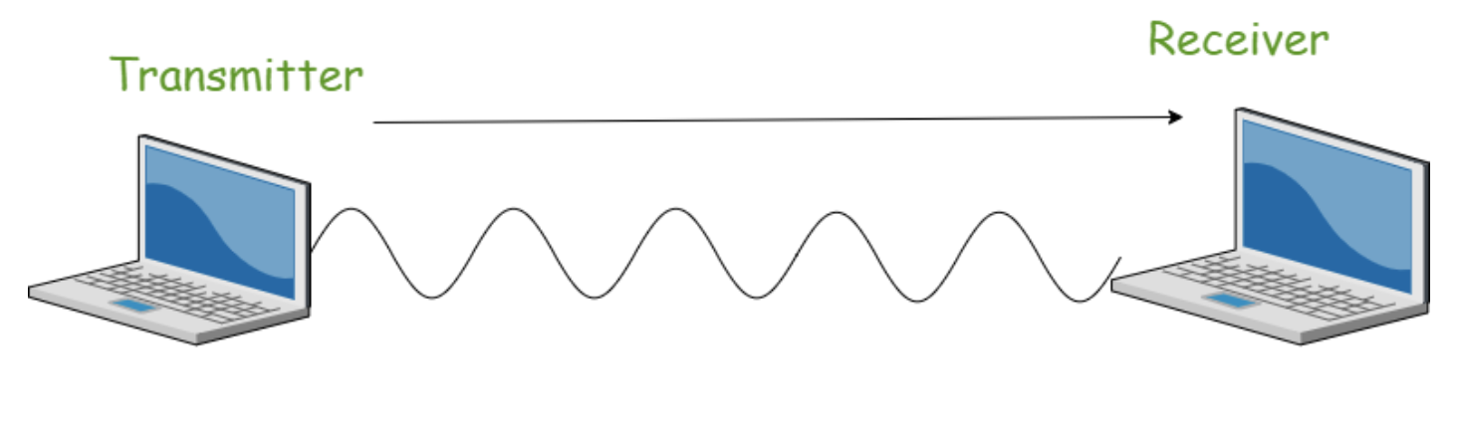
Wireless Communication
Wireless communication involves the transmission of information over a distance without the help of wires or cables.
Wireless communication takes place over free space through RF (radio frequency).
Source: Internet, GeeksforGeeks, Wireless Communication | Set 1

Slide 5
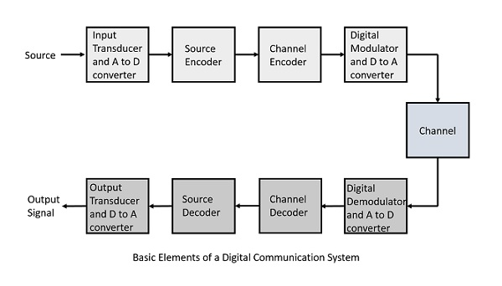
Elements of Wireless Communication
A typical wireless communication system can be divided into three elements: Transmitter, Channel and Receiver.
Source: Internet, Tutorialspoint, Digital Communication - Quick Guide

Slide 6
Frequencies for Radio Communication
Radio frequency is easier to generate and because of its large wavelength it can penetrate through walls and any structures.
Signal is a meaningful information that actually transmitted.
Noise is an unwanted signal which interferes with the original message signal.
Types of Noise:
External Source:
Internal Source:

Slide 7
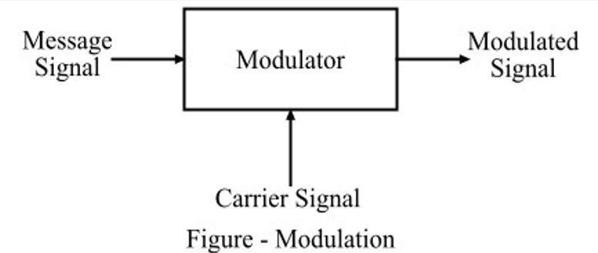
Modulation and Demodulation
Modulation is the process of converting data into radio waves by adding information to an electronic or optical carrier signal.
Source: Internet, Tutorialspoint, Modulation and Demodulation

Slide 8
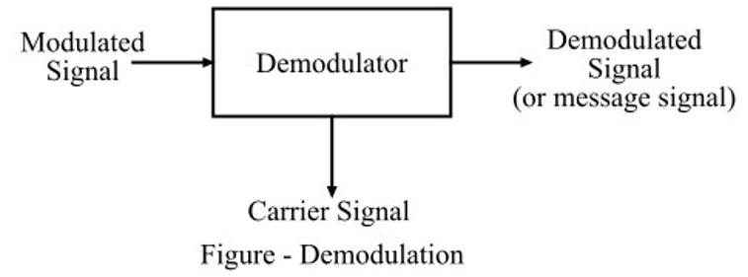
Cont'd
The process of the original message from the modulated signal is called demodulation.
Source: Internet, Tutorialspoint, Modulation and Demodulation

Slide 9
Signals in Modulation
There are three types of signals in the modulation process:
Message or Modulating Signal: The signal which contains a message to be transmitted, is called as a message signal.
Carrier Signal: The high frequency signal which has a certain phase, frequency but contains no information, is called a carrier signal.
Modulated Signal: The resultant signal after the process of modulation, is called as the modulated signal.

Slide 10
Analog Modulation Schemes
Amplitude Modulation (AM)
Frequency Modulation (FM)
There is a change in the frequency of the carrier wave if the signal voltage changes. It is known as frequency modulation.

Slide 11
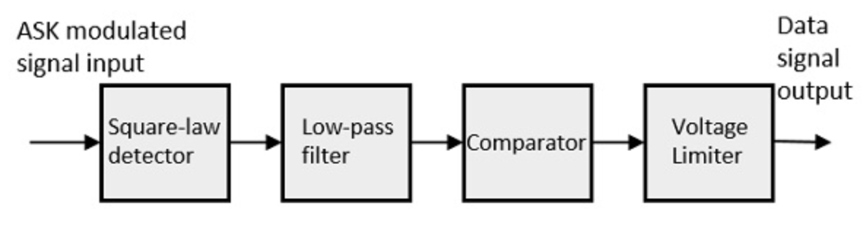
Amplitude Shift Keying
ASK is a type of Amplitude Modulation which represents the binary data in the form of a signal.
The binary signal when ASK modulated, gives a zero value for Low input while it gives the carrier output for High input.
Source: Internet, Tutorialspoint, Amplitude Shift Keying

Slide 12
Frequency Shift Keying
FSK is the digital modulation technique in which the frequency of the carrier signal varies according to the digital signal changes.
The output of a FSK modulated wave is high in frequency for a binary High input and is low in frequency for a binary Low input. The binary 1s and 0s are called Mark and Space frequencies.

Slide 13
Phase Shift Keying
PSK technique is widely used for wireless LANs, bio-metric, contactless operations, along with RFID and Bluetooth communications.
PSK is of two types:
Binary Phase Shift Keying (BPSK)
Quadrature Phase Shift Keying (QPSK)

Slide 14
BPSK and QPSK
BPSK: This is also called as 2-phase PSK or Phase Keying. In this technique, the sine wave carrier takes two phase such as 0° and 180°.
QPSK: This is the phase shift keying technique, in which the sine wave carrier takes four phase such as 0°, 90°, 180°, and 270°.

Slide 15
Multiplexing and Multiple Access Techniques
When the aggregation of channels is done before the modulation process, it is known as multiplexing.
When several independent stations access a medium, is the term “multiple access” is applied.
Types of Multiple Access Techniques.
FDMA (Frequency Division Multiple Access)
TDMA (Time Division Multiple Access)
CDMA (Code Division Multiple Access)

Slide 16
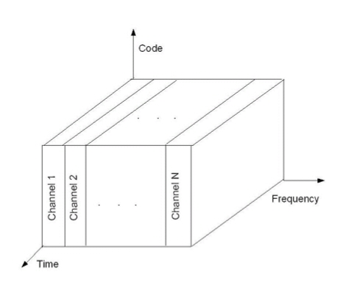
Frequency Division Multiple Access
Multiple-access technique for cellular systems in which each individual user is assigned a pair of frequencies while making or receiving a call.
Source: Jochen H. Schiller, Mobile. Communications, 2nd Edition, Addison-Wesley

Slide 17
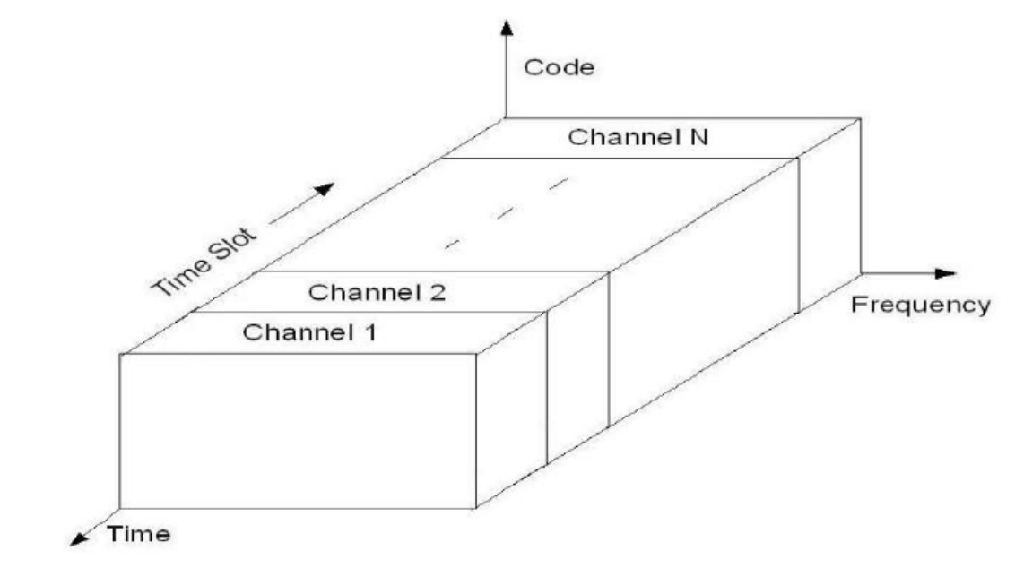
Time Division Multiple Access
In TDMA, the entire bandwidth is available to the user but only for a finite period of time.
Source: Jochen H. Schiller, Mobile. Communications, 2nd Edition, Addison-Wesley

Slide 18
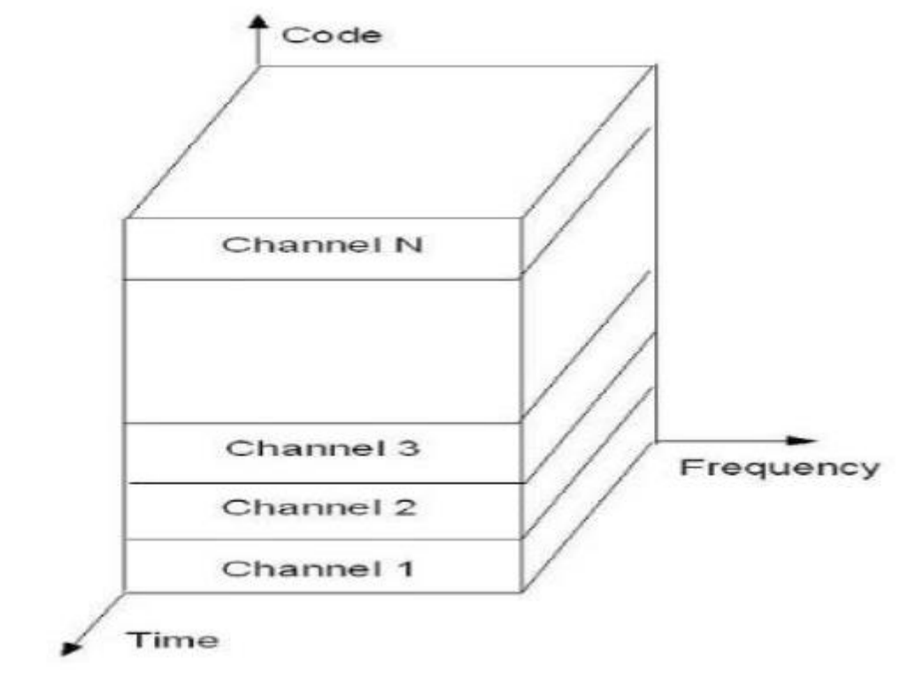
Code Division Multiple Access
In CDMA, the same bandwidth is occupied by all the users, however they are all assigned separate codes, which different them from each other.
Source: Jochen H. Schiller, Mobile. Communications, 2nd Edition, Addison-Wesley

Slide 19
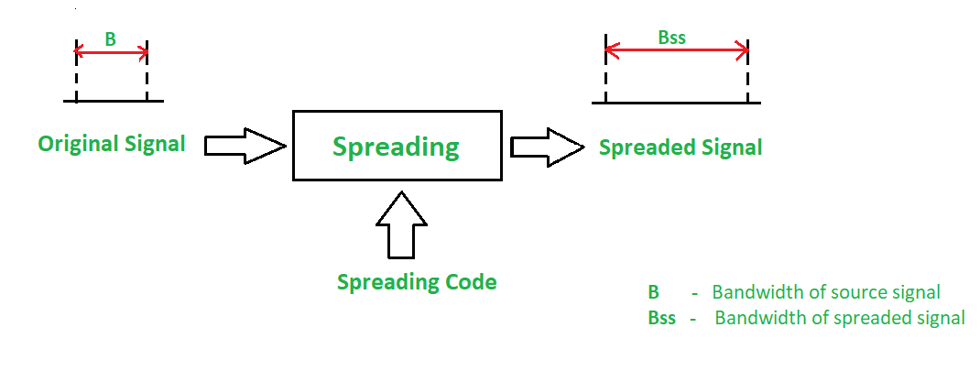
Spread Spectrum Modulation
In the spread spectrum, signals from different sources are combined to fit into larger bandwidth.
Source: Internet, GeeksforGeeks, Spread Spectrum

Slide 20
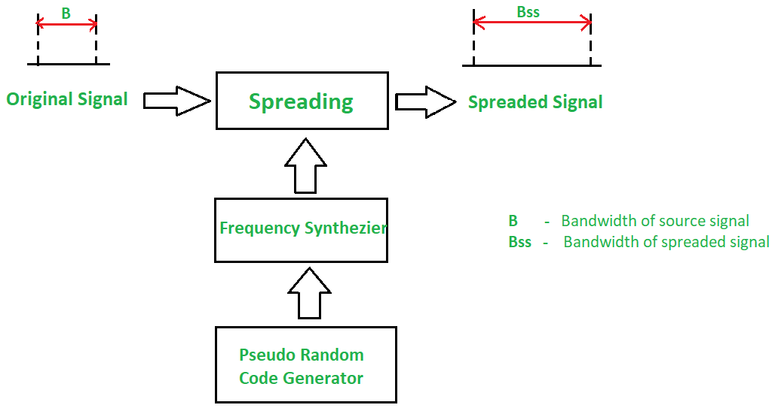
Frequency Hopping Spread Spectrum
In Frequency Hopping Spread Spectrum (FHSS), different carrier frequencies are modulated by the source signal.
Source: Internet, GeeksforGeeks, Spread Spectrum

Slide 21
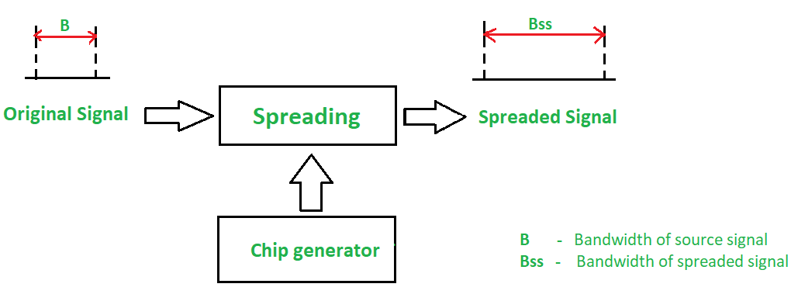
Direct Sequence Spread Spectrum
In DSSS, the bandwidth of the original signal is also expanded by a different technique. Here, each data bit is replaced with n bits using a spreading code called chips, and the bit rate of the chip is called as chip-rate.
Source: Internet, GeeksforGeeks, Spread Spectrum

Slide 22
Thank You

